Slide 1

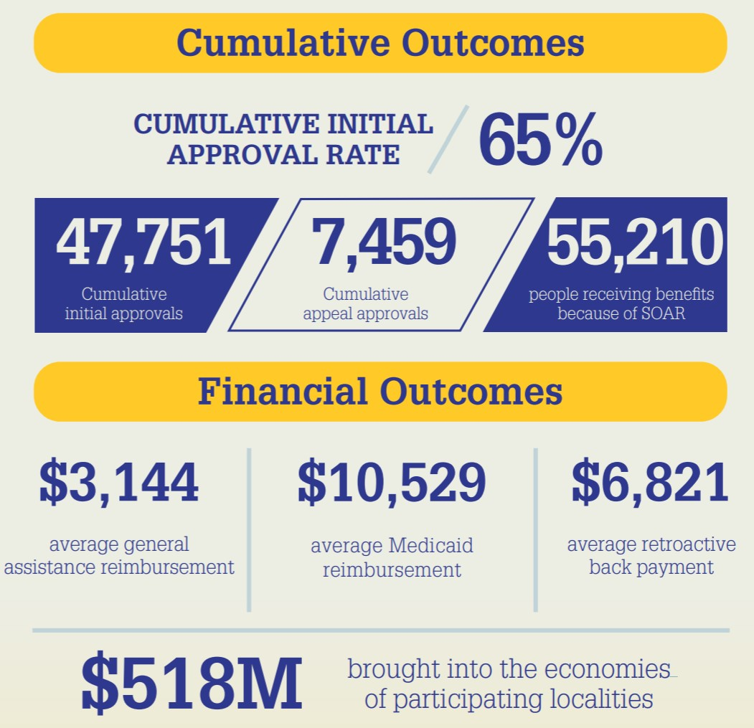
SAMHSA SOAR Initiative
SSI/SSDI, Outreach, Access, and Recovery (SOAR) is a model for assisting eligible adults and children who are experiencing or at risk of homelessness and have a serious mental illness or co-occurring substance use disorder to apply for Social Security Administration (SSA) disability benefits
  Facilitates access to health care and housing
  Provides increased education and employment opportunities
  Decreases incarcerations, institutionalization, and hospitalizations
In 2020, decisions on 6,565 SOAR initial applications were received in an average of 115 days with an allowance rate of 65 percent*
*This compares to the initial allowance rate of 30.8 percent for all persons aged 18-64 who applied for SSI or SSDI in 2019.

Slide 2

Benefits of the SOAR Online Course
Standardized training provided across all geographic areas
SOAR Leaders can coordinate follow-up training and support
Course is FREE, web-based, and self-guided
20 CEUs from National Association of Social Workers (NASW)

Slide 3
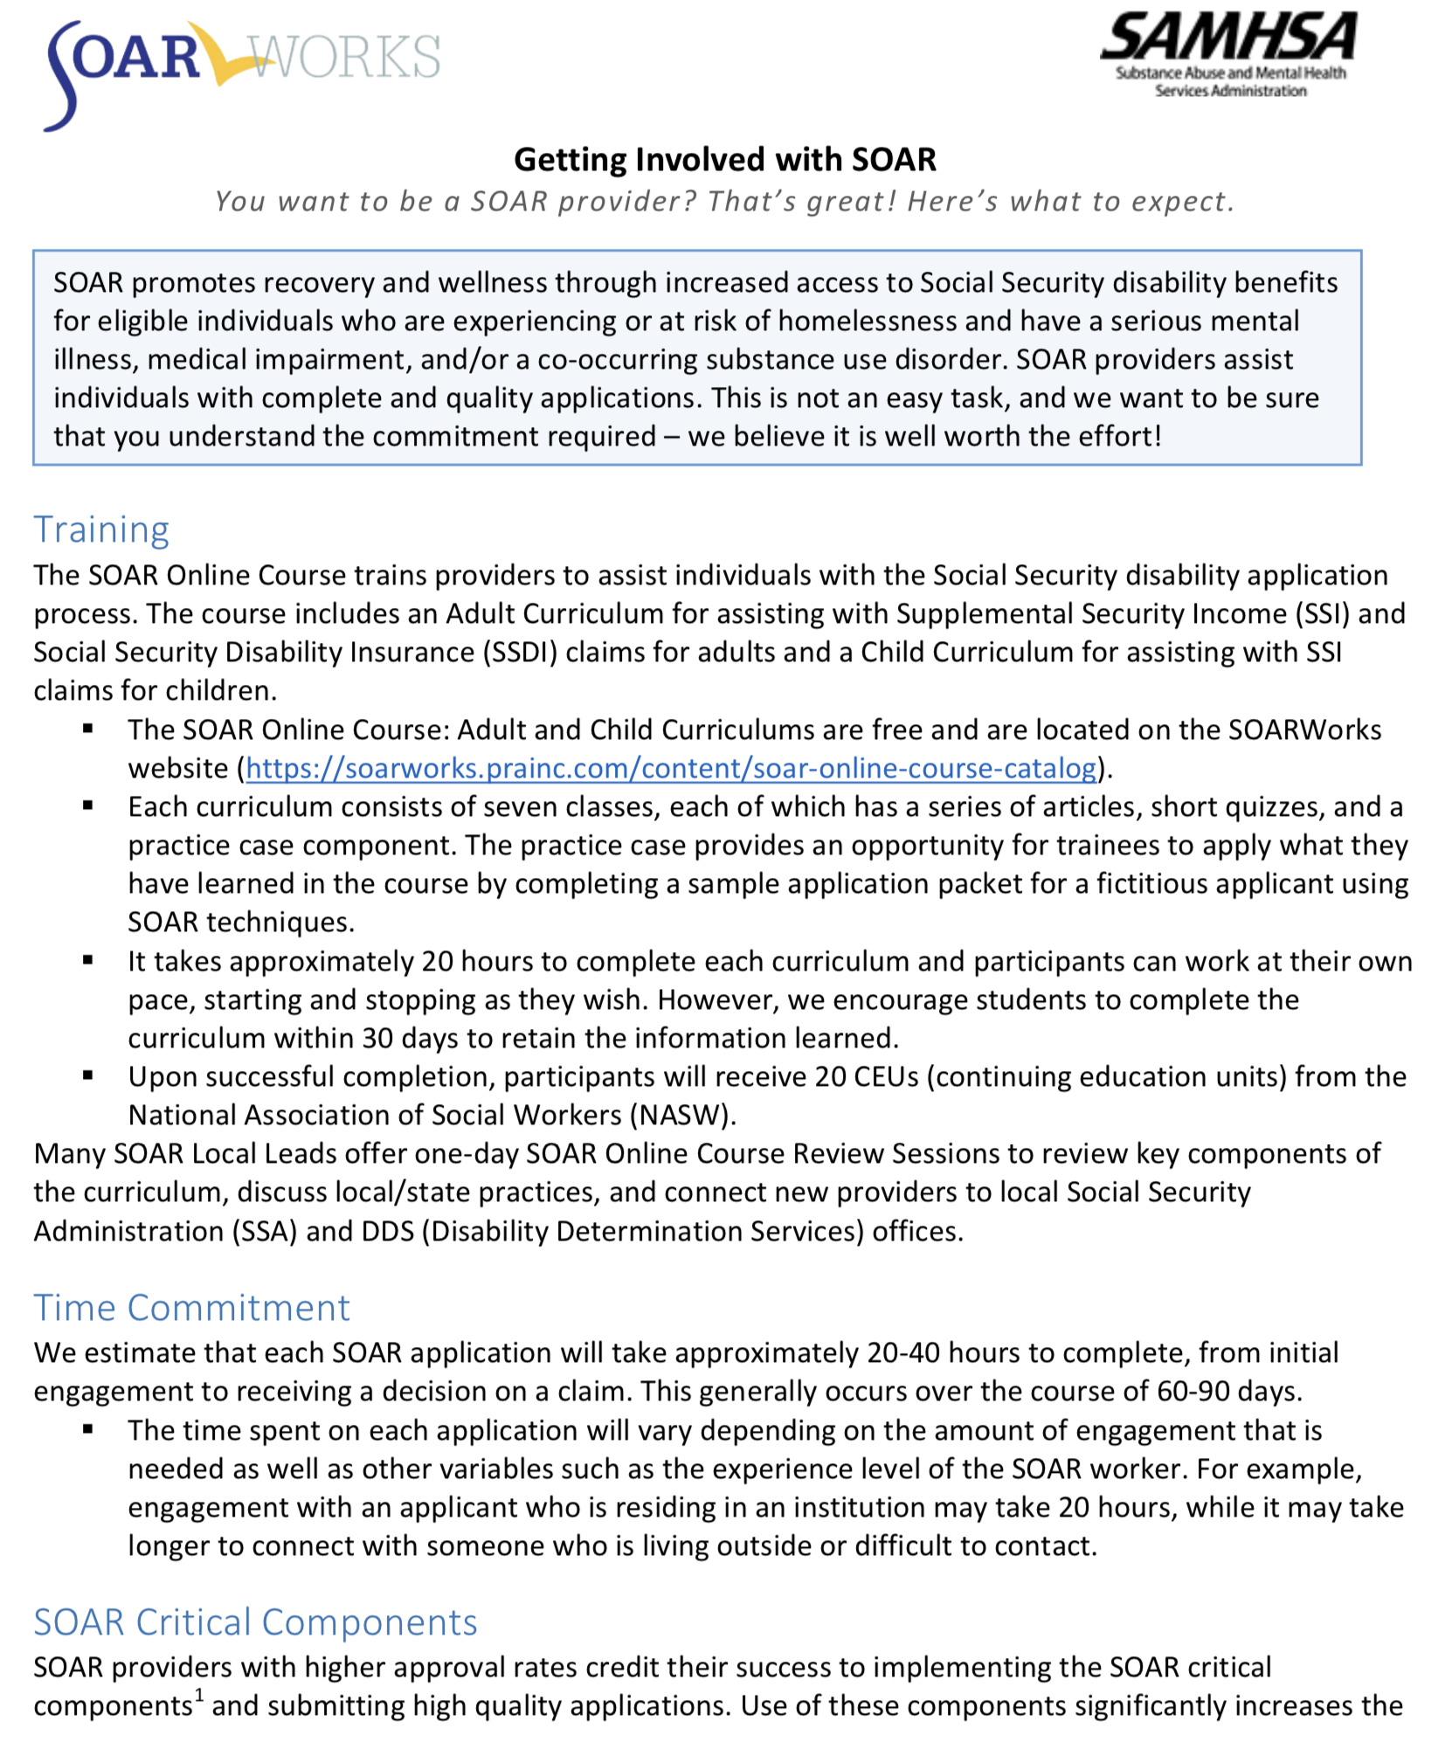
Getting Involved: Time Commitment
Training: 20 hours
20-40 hours per complete application
SOAR Critical Components
Outcome Tracking
Benefit to Your Agency and the Individuals You Serve

Slide 4

Online Application Tracking (OAT)
Web based
User friendly
HIPAA compliant
Monitors quality
Takes only 3-5 minutes
It’s FREE!
All the reasons OAT is awesome!
https://soartrack.prainc.com

Slide 5
Additional Resources
SOAR Overview: https://soarworks.prainc.com/sites/soarworks.prainc.com/files/SOAROverview-2020-508_0.pdf
Getting Involved with SOAR: https://soarworks.prainc.com/sites/soarworks.prainc.com/files/Getting_Involved_with_SOAR-Adult-and_Child.docx
SOAR Outcomes:
https://soarworks.prainc.com/article/soar-outcomes-and-impact
Implementing State and Local SOAR Initiatives: https://soarworks.prainc.com/sites/soarworks.prainc.com/files/Implementing_State_Local_SOAR_Initiatives-Adult_and_Child.docx
SOAR Online Course Catalog:
https://soarworks.prainc.com/content/soar-online-course-catalog

Slide 6
Connect With Us
Abigail Kirkman
SAMHSA SOAR TA Center
Assistant Director
Colorado SOAR Liaison
akirkman@prainc.com
(518) 439-7415, EXT: 5226
SOAR State Team Leads
Terri Townsend
terri.townsend@delaware.gov
(302) 739-5601, EXT: 5373
Paula Witcher
paula.witcher@vmcenter.org
(302) 505-0849

