Slide 1

Housing Locator Program
Housing Authority of the County of Chester Pennsylvania

Slide 2
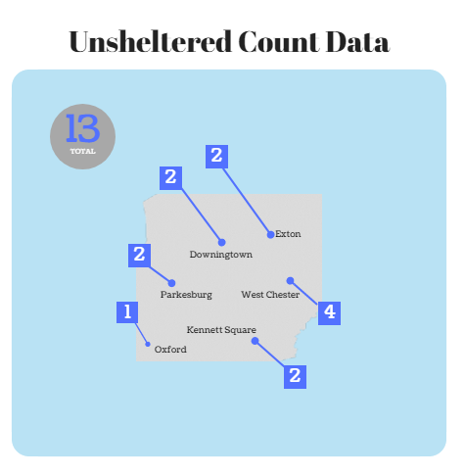
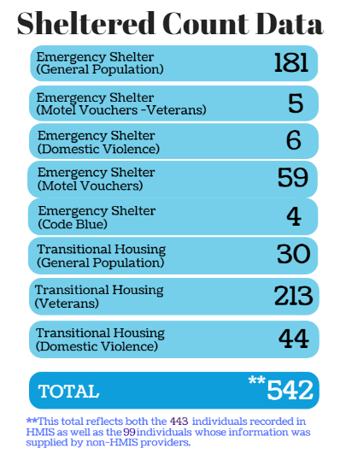
In 2018, there were 13 unsheltered and 542 sheltered for a total of 555 people experiencing homelessness in Chester County

Slide 3
Why?
The Housing Locator Program was developed to fill a gap in services in Chester County
  Gap:
    Low Housing Inventory for Low Income Families
    Low Lease-Up Rate for Subsidy Holders (Section8/HCV & Rapid Rehousing Program)

Slide 4
Who?
Eligibility for the HLP program applies to Chester County residents experiencing homelessness or in danger of becoming homeless
The program works by referrals, with majority of referrals coming off of Chester County’s System-Entry Homeless Queue
Intakes are completed In-Person
  To encourage rapport building
  To ensure that Coc requisite paperwork is completed and signed by the participants
  Take place at HACC offices or anywhere in county (e.g., Shelters, Libraries, Partner Agencies, etc.

Slide 5
How?
The goal of the HLP is to link households that need housing with landlords that have affordable units for rent
  This is accomplished by Outreach to County Landlords
    Drive-Bys, Cold-Calls and Net-Nav (e.g., _____________
    Visiting Units with Participants and Meeting Landlords (Rapport Building)
    Explaining various subsidies, affordability and rent reasonableness (Guidance)
    Providing Incentives (e.g., Landlord Risk Reduction Fund)
    Hosting Biannual Landlord Forums (Education & Networking)
    Housing Locators must be available to landlords; return calls and emails promptly, answer questions, and support landlords throughout the landlord/tenant relationship

Slide 6
Notes:
79 People housed but a higher number in impacted areas

Slide 7
Notes:
58 people housed but more people outside of impacted areas

Slide 8
Total people to come through the HLP in 2018
90 families – 219 people
Coatesville– 33 families
Average days to house a family – 38.3
West Chester – 6 families
Average days to house a family – 105.1
Downingtown – 6 families
Average days to house a family – 87.1
Oxford– 2 families
Average days to house a family – 71.5
Phoenixville – 7 families
Average days to house a family – 55.7
Kennett Square – 1 family
It took 54 days to place family in Kennett Square
Newtown Square– 1 family
It took 47 days to place family in Newtown Square

